Slide 1
Heat Pumps

Slide 2

By the end of this lesson, you should be able to:
Understand heat transfer and the relationship between the pressure and temperature of a substance.
Explain how heat transfer and pressure changes are used to move heat in heat pumps.
Describe the changes in state, temperature and pressure refrigerants experience during heat pump cycles.

Slide 3

Before going into the workings of a heatpump, we need to learn two key principles.
1. How heat moves.
2. How pressure affects the temperature of a fluid.

Slide 4
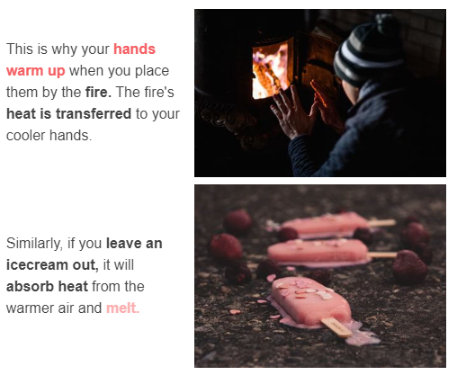
Heat always moves from a hot substance to a cold substance.

Slide 5
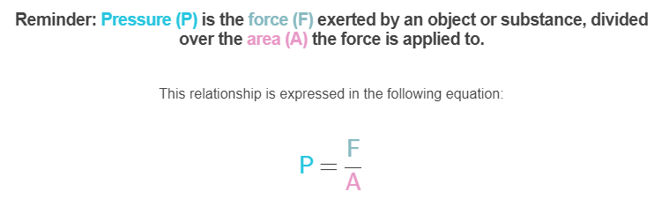
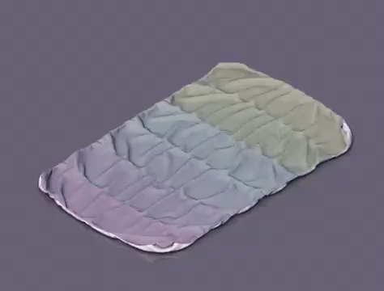

Slide 6
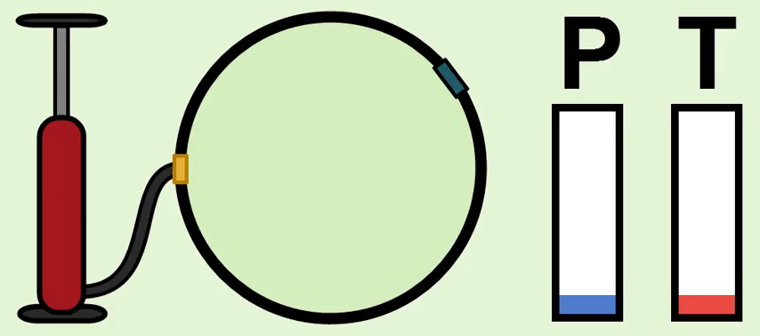
Just as in gases, changing the pressure of a liquid changes its temperature.
Increasing the pressure of a gas or liquid increases the temperature of the substance.
Decreasing the pressure of a gas or liquid decreases the temperature of the substance.

Slide 7
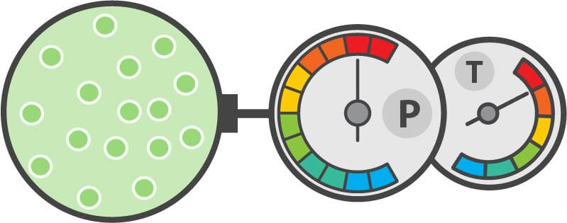
You can change the pressure of a gas or liquid by changing how close together their particles are.
Compressing a substance so that its particles are closer together increases the pressure.
A compressed fluid or gas also becomes hotter because, as pressure rises, temperature rises.

Slide 8
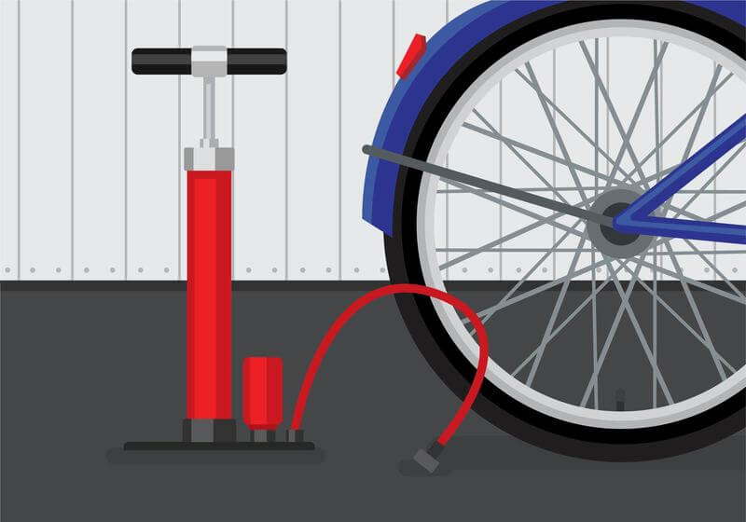
You can observe how compressing gas particles increases temperature and pressure at home.
When you pump up bike tyres, you are compressing air particles inside the tyre to increase tyre pressure. This causes the tyre to inflate.
Try pumping as much air into your bike tyre as you can, and then touch it. It should feel warm!

Slide 9
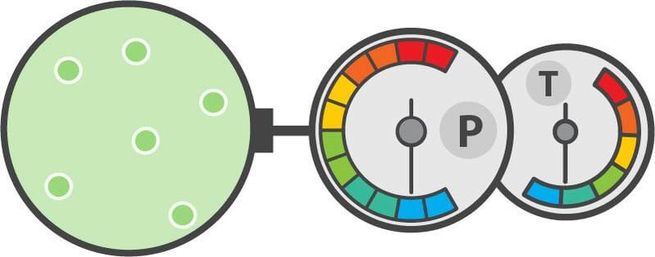
You can change the pressure of a gas or liquid by changing how close together their particles are.
Expanding a substance so that its particles are farther apart decreases the pressure.
A fluid or gas that has been expanded also becomes colder because, as pressure drops, temperature drops.

Slide 10
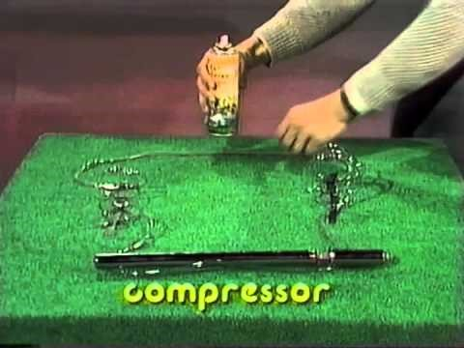

Slide 11
Summary: The relationship between pressure and temperature in fluids and gases.
Changing the pressure of a fluid or gas changes its temperature.
Increasing the pressure of a fluid or gas makes it hotter.
Decreasing the pressure of a fluid or gas makes it colder.

Slide 12
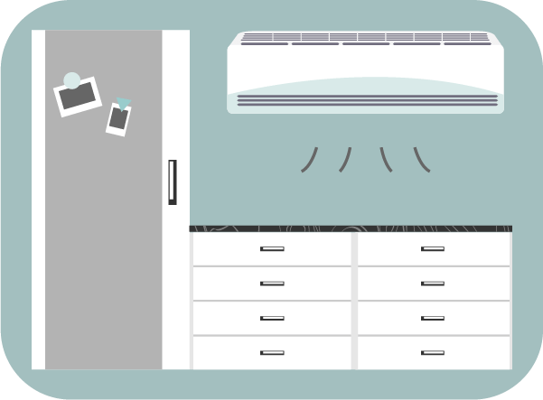
Heat exchange and pressure changes are used in heat pumps and refrigerators!
Fluid temperature is increased by exposing it to something hot so that it absorbs heat, or increasing its pressure.
Fluid temperature is decreased by exposing it to something cold so that it releases heat, or decreasing its pressure.

Slide 13
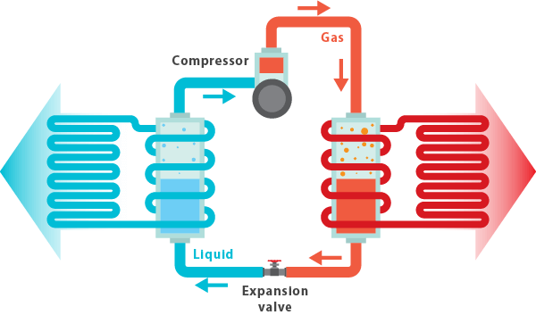
Heat pumps (also known as heaters) are a clever invention that transfer heat from the outside air into your home, keeping you warm.
Heat pumps work by moving a chemical called a refrigerant around in a cycle. During this cycle, the refrigerant experiences changes in temperature, pressure and state.
Let's learn what happens during the heat pump cycle and how this allows a heat pump to move heat from outside to inside.

Slide 14
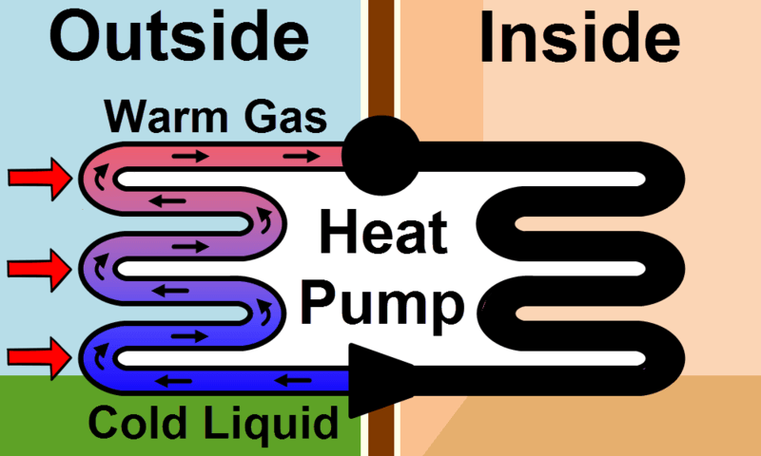
The refrigerant begins the heat pump cycle as a very cold liquid.
The refrigerant runs through piping that is exposed to the outside air. The refrigerant is colder than the outside air, so it absorbs heat from outside.
This warms up the refrigerant, causing it to evaporate into a gas.

Slide 15
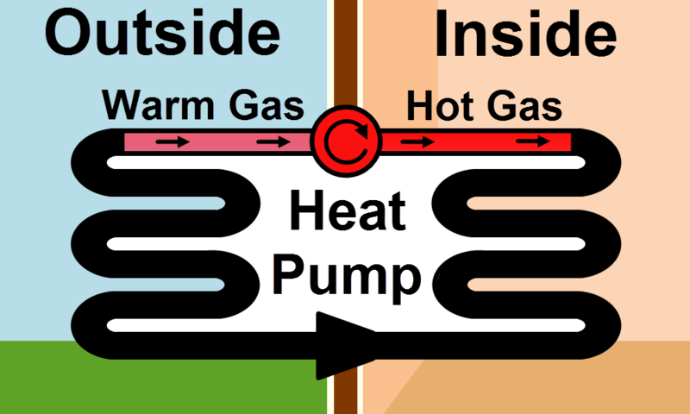
The refrigerant is warmer, but not yet hot enough to heat your house.
To heat the gas further, it is moved through a compressor. This increases the pressure and temperature of the gas.
Now the refrigerant is a very hot, high pressured gas!

Slide 16
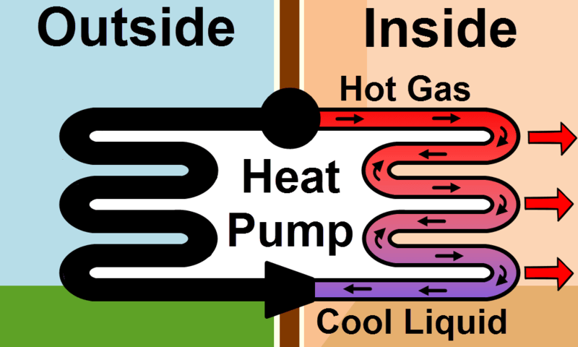
After being compressed, the hot gas is run through pipes that are exposed to the air inside your house.
The gas is hotter than the air in your house, so it releases heat into the room.
This warms your home and cools the gas down.
As a result, the refrigerant condenses back into a liquid.

Slide 17
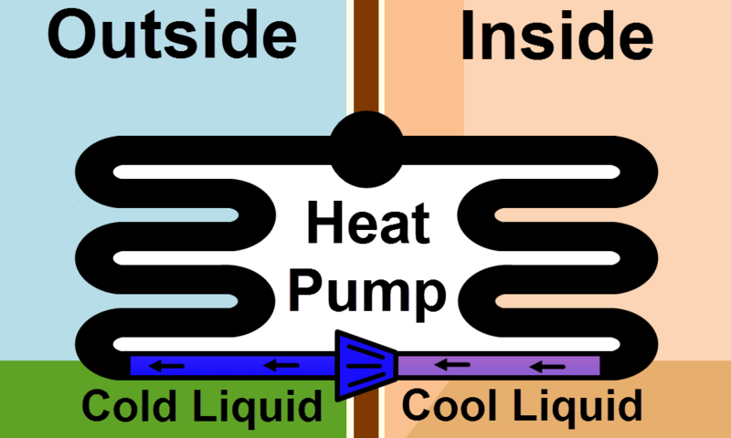
Finally, the liquid refrigerant is run through an expanding device.
Running the liquid through an expanding valve decreases its pressure, producing a very cold, low pressure liquid refrigerant.
Now the refrigerant is ready to start the cycle over again, as it is now cold enough to absorb heat from the outside air.

Slide 18
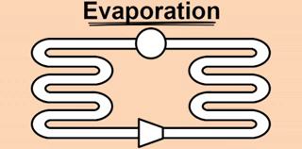
Let's review what happens to the refrigerant in a heat pump cycle.
1. | It starts as a cold liquid, which absorbs heat from the outside air and evaporates into a gas.
2. | The gas runs through a compressor, which increases its pressure and temperature, producing a hot, high pressure gas.
3. | The hot gas releases the heat it absorbed into the house and condenses into a liquid.
4. | The liquid is then run through an expanding device to reduce its pressure and temperature, making it cold enough to absorb heat from the outside air.

Slide 19
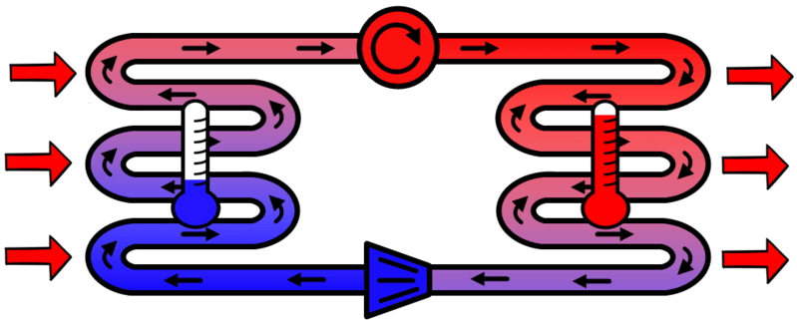
Changing the pressure of the refrigerant allows its temperature to be manipulated.
Expanding the refrigerant before it goes outside ensures it is colder than the outside air so it will absorb heat.
Compressing the refrigerant before it comes inside ensures that it is hotter than the inside air so it will emit heat.
In other words, controlling the refrigerant's pressure ensures heat is being moved in the right direction.

Slide 20
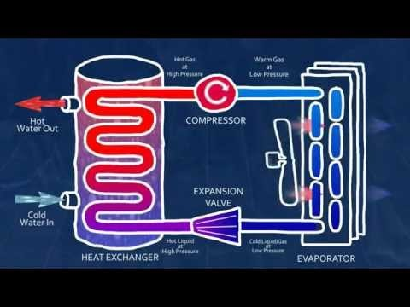

Slide 21
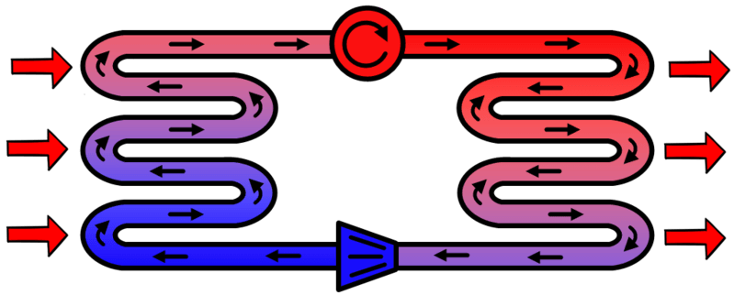
Heat pump summary:
The heat pump pushes a refrigerant through a cycle where it absorbs heat from outside and emits heat inside. This keeps you and your house warm!
When the refrigerant absorbs heat, it evaporates. When it releases heat, it condenses.
During the heat pump cycles, the refrigerant's pressure is controlled to ensure it is moving heat in the correct direction.

